Slide 1
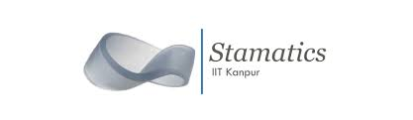
Group –2 Presented on Student Alcohol Consumption Analysis using Multiple Linear Regression Model
Presented by
Prithwijit Ghosh
Amit Meena

Slide 2

INTRODUCTION
Drinking has negative effects on young students, their families, and their respective schools or colleges. According to an extensive research from the NIAAA in 2015, drinking has been prevalent among 86.4% of students ages 18 and above. The same report noted that 1,825 college students 18 to 24 years old lost their lives due to alcohol-related road accidents. Roughly 97,000 students in the same age range have been involved in sexual assaults and rape due to excessive drinking. So in between the age period 15-22 years students get destroyed by the attraction to consumption of alcohol , they are losing their real ability and efficiency and creating a bad environment for others. Obviously this bad habit also affects their academic career…..

Slide 3
Data Description
Data-set Description
Our data contain full information about the relationship of students grades with their other activities e.g. alcohol consumption habit, in the student life whether they fall into relationship etc. So, obviously here our target variable is the final grade of the student i.e.
G3 → final grades, where these grades are related with the course subject, Math or Portuguese.
Now Our regressor variables are both types i.e. categorical and continuous. In categorical columns student’s school, sex, address etc. are included and simultaneously in the continuous columns student’s grade in the first period(G1),grade in the second period, health, workday alcohol consumption habits, weekend alcohol consumption habit etc. are included. In our data-set there exists a tidy number of binary variables i.e. discrete variables taking only two possible values corresponding to happening or non-happening of a particular event. In this case they are namely student’s extra educational support, family educational supports, internet access, whether he/she fall in relationship etc.

Slide 4
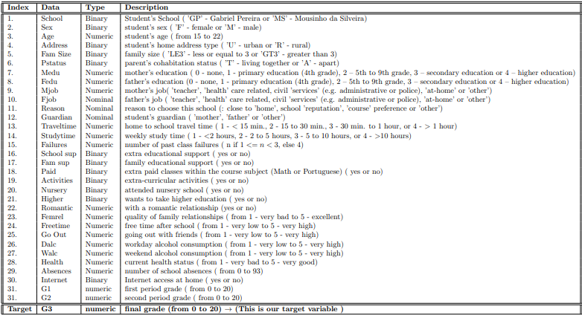
Dataset description
So the complete description of our regressors and response variable is given below –

Slide 5
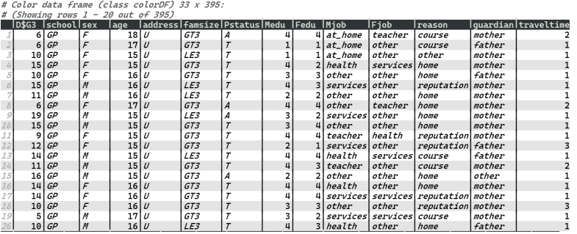
Glimpse Of Data-set
We have done a sufficient discussion based on our data-set. Now we move forward and go for a further study. at first we look into the data-set at a glance and then we pictorially observe the columns of our data-set.

Slide 6
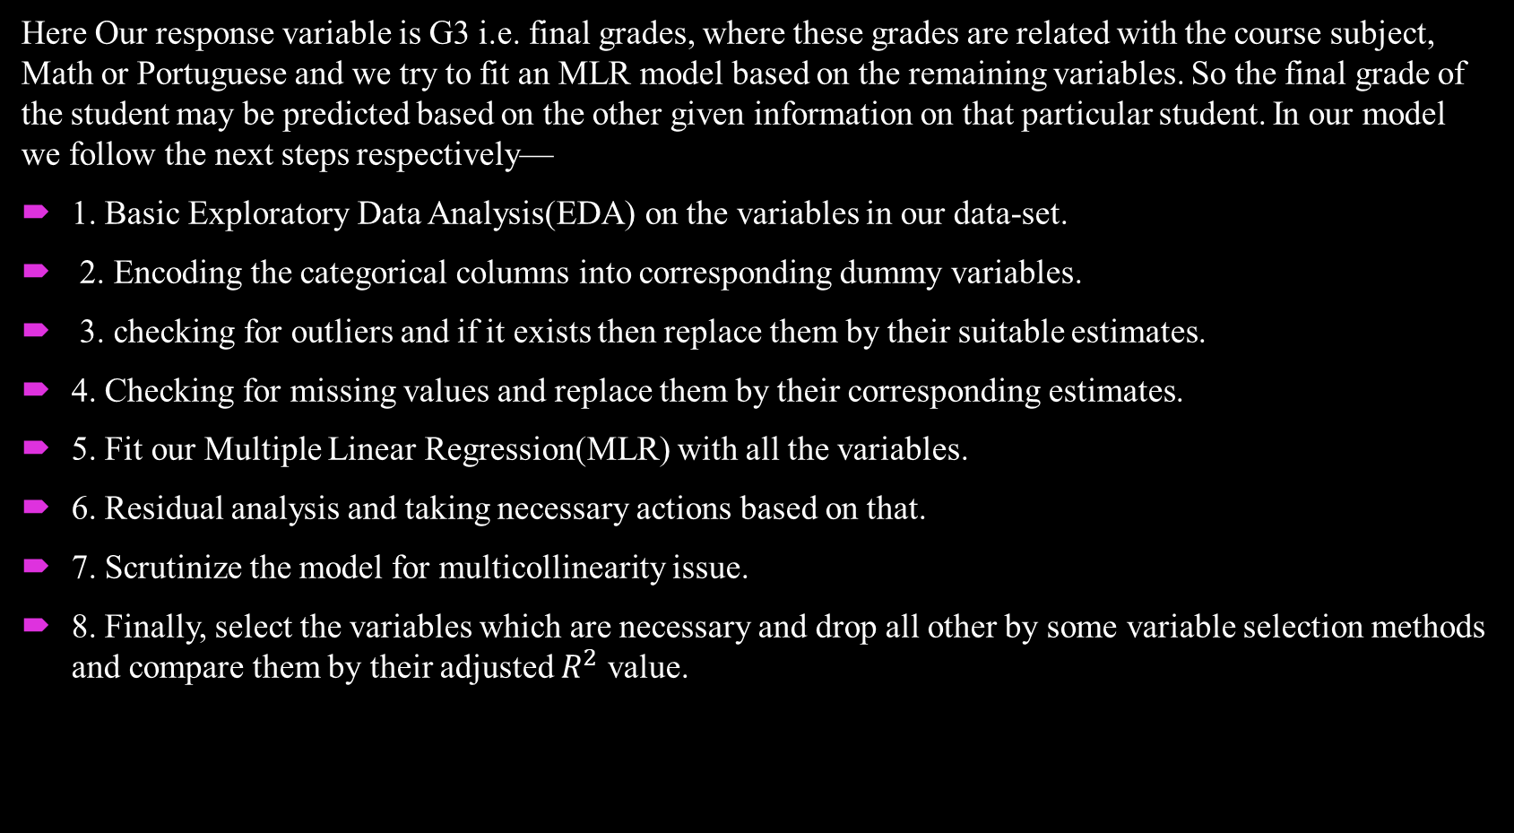
Goal of Our Study
Here Our response variable is G3 i.e. final grades, where these grades are related with the course subject, Math or Portuguese and we try to fit an MLR model based on the remaining variables. So the final grade of the student may be predicted based on the other given information on that particular student. In our model we follow the next steps respectively—
1. Basic Exploratory Data Analysis(EDA) on the variables in our data-set.
2. Encoding the categorical columns into corresponding dummy variables.
3. checking for outliers and if it exists then replace them by their suitable estimates.
4. Checking for missing values and replace them by their corresponding estimates.
5. Fit our Multiple Linear Regression(MLR) with all the variables.
6. Residual analysis and taking necessary actions based on that.
7. Scrutinize the model for multicollinearity issue.
8. Finally, select the variables which are necessary and drop all other by some variable selection methods and compare them by their adjusted $R^{2}$ value.

Slide 7

Exploratory Data Analysis(EDA)
For every data-set we have to perform the some amount of exploratory data analysis. At first we have to visualize the pattern of the data for necessary columns and also their interrelations via some sort of critical analysis and then some great deal of visualizing tools.
Data Standardization
If the data is the usual raw data as taken from the field, then the further statistical analysis become too much cumbersome. Ruling out this difficulty and making the usual compatibility we have standardize the data. By standardization we simply mean that for a particular variable at first the mean has to be subtracted and then the resultant has to be divided by the standard deviation of that variable for each observations. So, mathematically,
standardized variable = $\frac{\text{Raw} \text{V} \text{ariable}\text{ − }\text{mean}}{\text{Standard} \text{Deviation}}$

Slide 8
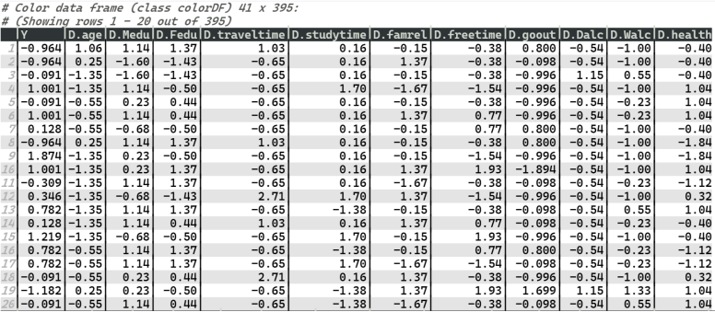
Data Standardization
And our data-set after standardizing -

Slide 9
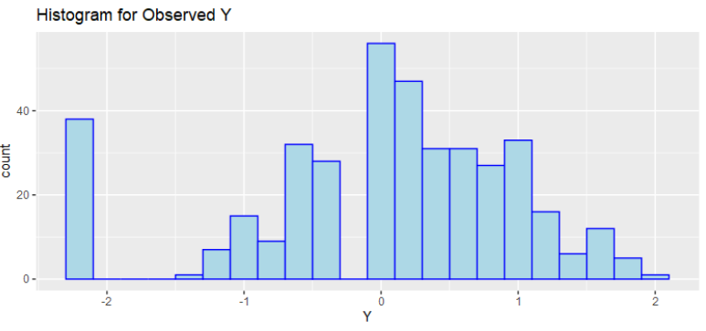
EDA on response variable
Here our response or target variable is G3 and it is a continuous variable. So, we can plot the histogram because in any MLR model the response variable should have a normal distribution for a smooth propagation of the classical linear model theory.
Here observing the histogram, it seems reasonable to assume that the distribution of the standardized response variable is nearly normal but only at the begging it takes a high jump.

Slide 10
EDA on remaining regressor variable
Let we will focus on the remaining regressor variable by simple bar-plot, histogram etc. since the regressor variables are treated as constant in MLR model so we only devote a small amount of EDA on them and we will move into our main model fitting purpose.
Box-plot
We first try to observe the box-plots for different regressor variables all taking together. Because box-plot gives 5-statistics summary not only in a neat and clean pictorial way but also shows the outlier(if any) by the dots. So looking all the regressors at one glance is best fitted by the box-plot. The box-plot for our data set is the following – Now the above box-plot clearly shows that the variables in our data-set are largely affected by the outliers and we will consider this part later.

Slide 11
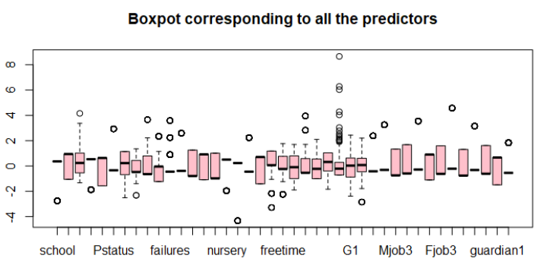
Box-Plot for Full data-set

Slide 12
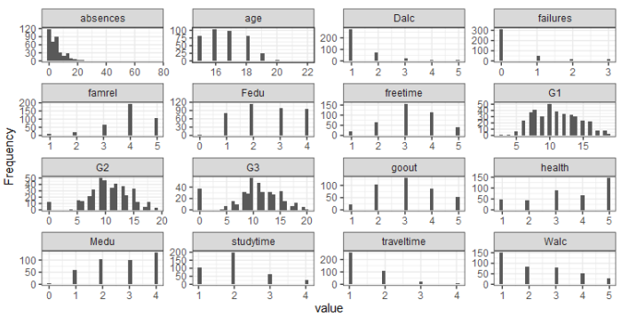
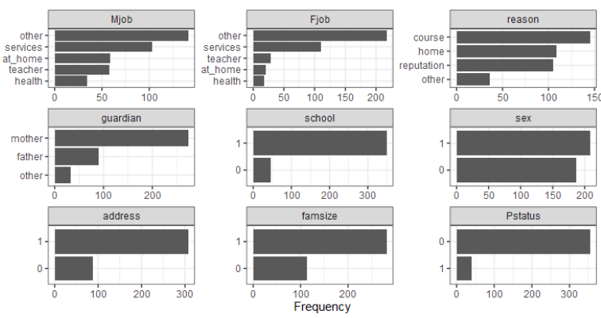
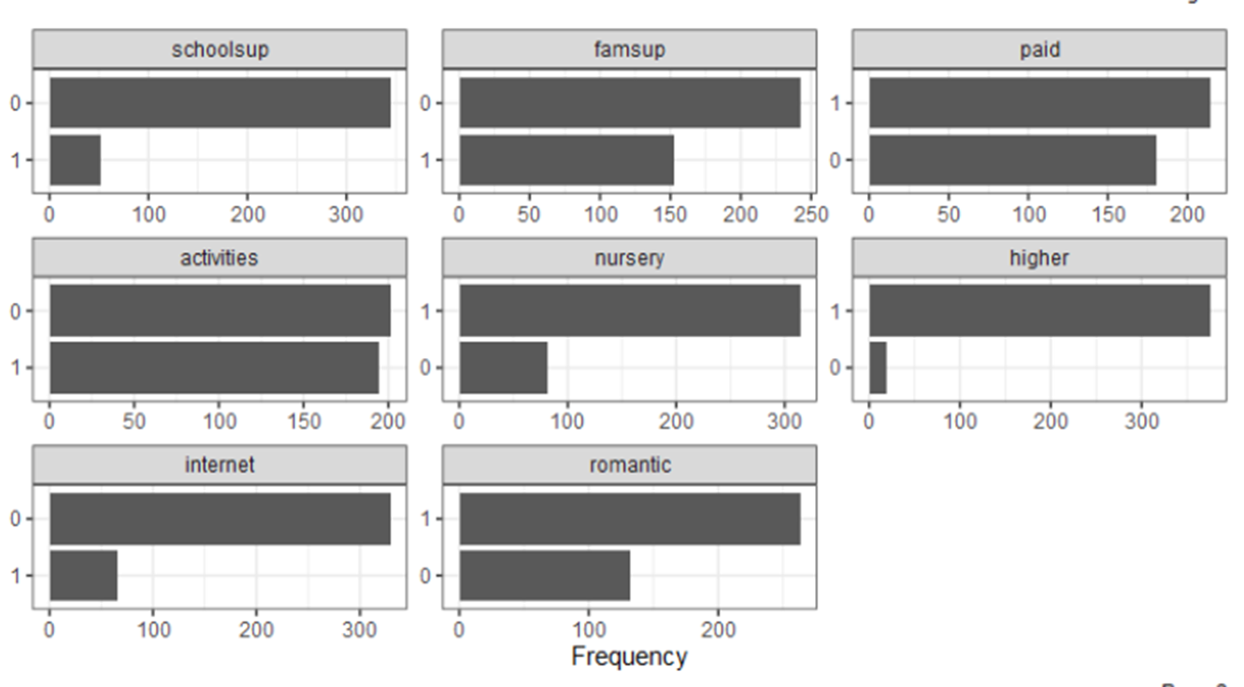
Histogram And Bar-plot
Box-plot says overall all the things except the fact the distribution of the of that variable can not be explained by a simple box-plot. So, we have to take care of this fact and hence for the discrete case we use the bar-plot and for the continuous case we use the histogram. for our data-set, those visualizations are described below –

Slide 13
Summary of EDA
Now from the histograms we can easily say that –
absences → positively skewed distribution.
G1 → symmetric distribution.
G2→ symmetric distribution.
G3→ symmetric distribution.
All others → Difficult to interpret due small range of the variables.
Let us now look into the binary and categorical variables by their corresponding horizontal

Slide 14
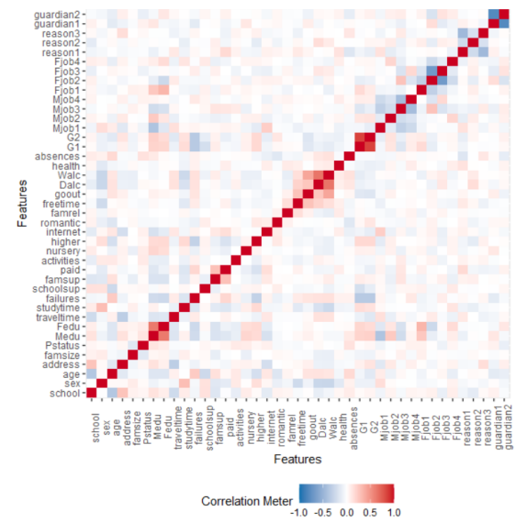
Correlation Heat-map
Now for observing the interrelation among the variables, here we mainly use the correlation matrix. But the correlation matrix is very difficult for visualization.
Hence here we goes into the correlation heat-map where the gradient in the color interpret
the higher or lower correlation among the variables. So below is the correlation heat-map for
our data-set. from the above colored correlation heat-map, reddish color indicates that the
correlation is positive and the bluish color indicates that the correlation is negative and the
the zero correlation is displayed by the whitish color

Slide 15
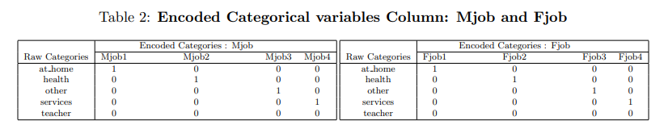
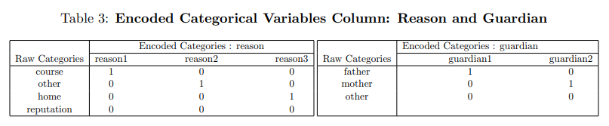
Data Encoding
we have four categorical variables and we have to convert them into the binary one’s. These categorical columns are - Mjob, Fjob, reason& guardian Total number of categories in the Mjob and the Fjob columns are 5 each, reason has 4 categories and finally guardian has only 3 categories. So as by the basic rule of encoding we can encode it into 4,4,3,2 numerical variables that takes on the values 0 or 1 respectively. The categories for these four columns are –
Mjob→”at home” , ”health” , ”other” , ”services”, ”teacher” Fjob→”at home” , ”health” , ”other” , ”services”, ”teacher” reason→”course” , ”other” , ”home”, ”reputation” guardian→”father”,”mother”,”other”
We are ready to encode this categorical columns in to numerical ones. Now the following table gives the summarization of what actually we want to say–
In the above four table we have finally converted the categorical columns into the binary
dummy variables. Now we proceed with our further analysis.

Slide 16
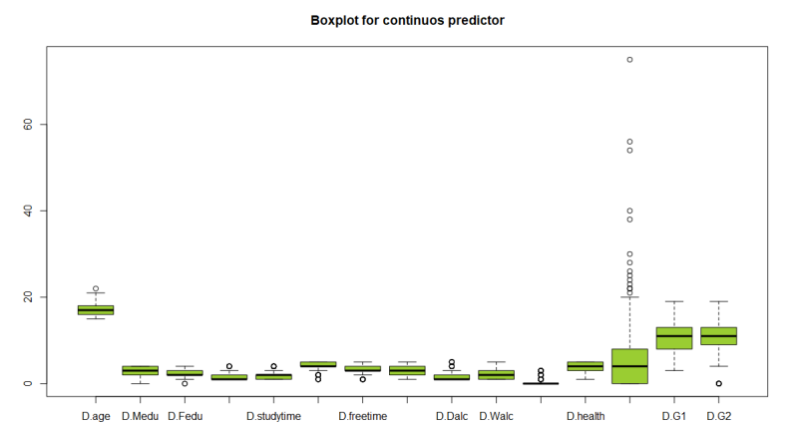
Outlier Detection
Outlier in the data plays a very important role when we came into the estimation purpose for the model parameter. So we have to remove or estimate the outliers based on the given scenario. For our model let us draw the box plots to see whether heavy amount of outliers present in our data or not for only the continuous columns. Because if we remove the outliers from the binary variables then it is not only meaningless but also there exists a situation where we can all the values corresponding to the lower class is removed and for further prosperity we have to drop the columns. If the number of outliers are quite small we can simply delete the corresponding rows, otherwise we proceed into further analysis.
Let us first see that the box-plots of the corresponding columns–

Slide 17
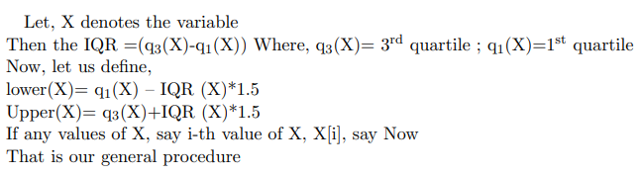
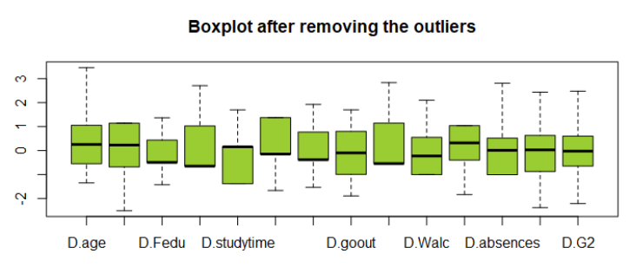
Box-Plots After Removing the Outlier
Since too much outliers are present in the data, we have to estimate them. Here we apply Interquartile Range method (IQR) for outlier detection and removal of outliers. Observing the boxplot, it is almost sure that the variables are skewed. So, IQR method suits well for such kind of data.

Slide 18
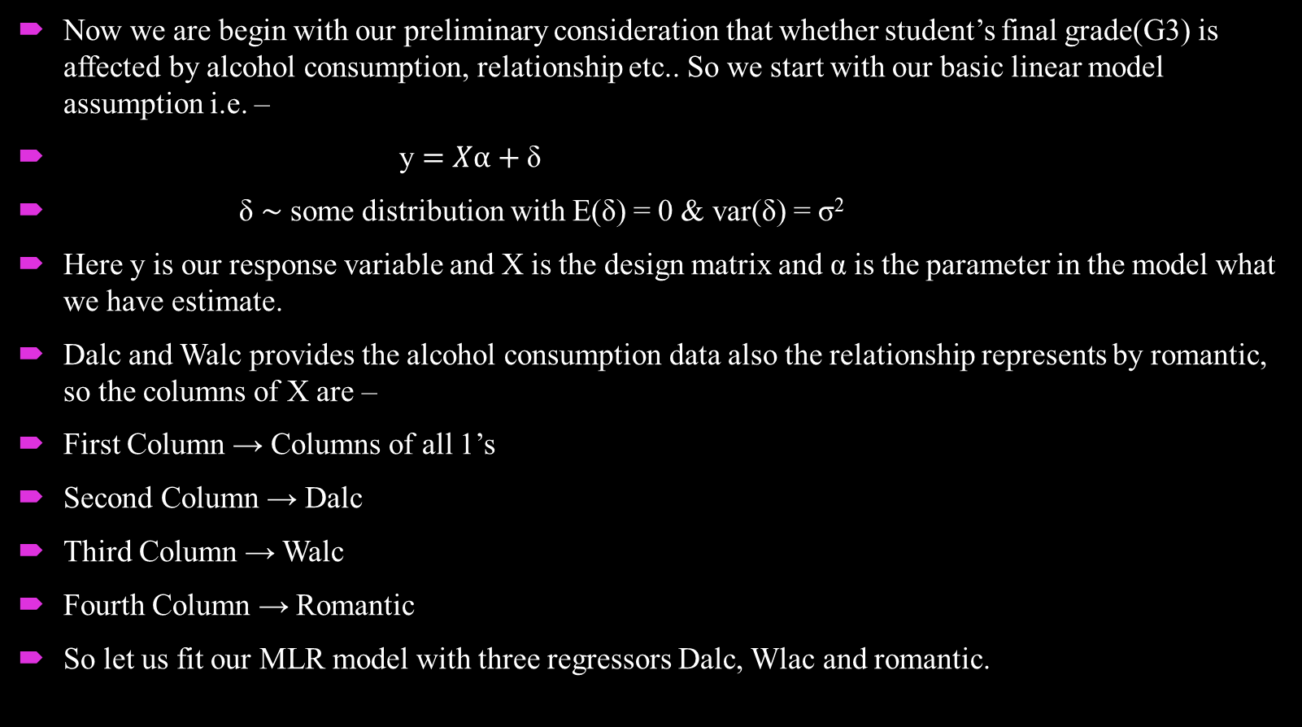
Linear regression on alcohol consumption
Now we are begin with our preliminary consideration that whether student’s final grade(G3) is affected by alcohol consumption, relationship etc.. So we start with our basic linear model assumption i.e. –
y $=Xα+\text{δ}$
δ ∼ some distribution with E(δ) = 0 & var(δ) = σ²
Here y is our response variable and X is the design matrix and α is the parameter in the model what we have estimate.
Dalc and Walc provides the alcohol consumption data also the relationship represents by romantic, so the columns of X are –
First Column → Columns of all 1’s
Second Column → Dalc
Third Column → Walc
Fourth Column → Romantic
So let us fit our MLR model with three regressors Dalc, Wlac and romantic.

Slide 19
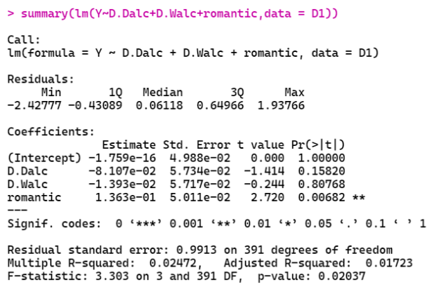

Data Summary
From the summary of the above model we can see that the $R^{2}$ value is 0.02472 and the adjusted $R^{2}$ value is 0.01723, which are very small to conclude any thing about the model. So a natural question arises that whether the regression is valid or not i.e. we have to test the hypothesis

Slide 20
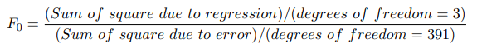
Final Result
For testing this hypothesis our test statistic is –
Here we assume that additionally
and
From the above figure we see that the value of the F-statistic is 3.303 and the corresponding p-value is 0.02037,which is greater than 0.01 and hence we can finally fail to reject H0 at 1% level of significance. So the values of all the parameter associated with the regressors are exactly equal to zero at 1% level of significance. Hence we finally conclude that the regression is not valid on the present scenario or equivalently Dalc, Walc and Romantic does not affect significantly on the student’s final grade.

Slide 21
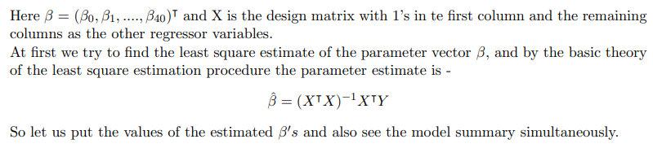
Full Model Building
Since from the previous discussion we see that the alcohol consumption has statistically no effect or insignificant for predicting anything about the final grade of the student. Hence we fit the full linear regression model i.e. the model with all the columns(except the column ”failure”, since it is a null column) as regressors and G3 as the response variable. So more mathematically,
Y = Xβ + ϵ
Where , ϵ ∼ some distribution with E(ϵ) = 0 & var(ϵ) = σ²

Slide 22
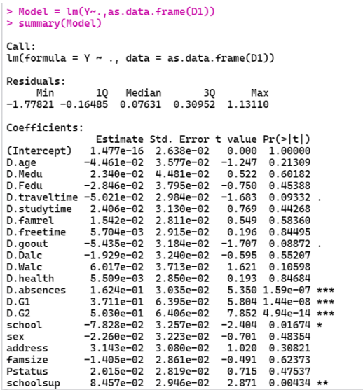
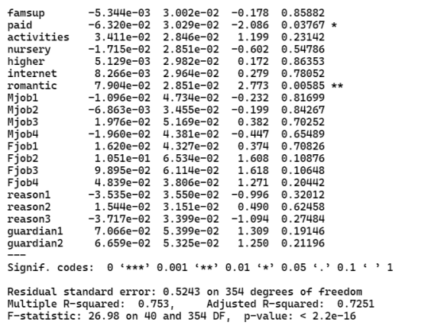
Full Model Data-Set Summary

Slide 23
Significance Of Regression
In the above picture the first column indicates the parameter estimates, second columns indicates the standard error of the estimates, third column indicates the corresponding t-value and the final column indicates the p-value corresponding to the t-value. As before we first check whether the regression is valid or not i.e.
As above explained —
For testing this hypothesis our test statistic is –
Here additionally we assume that,
From the above figure we see that the value of the F-statistic is 26.98 and the corresponding p-value is 2.2e-16,which is less than 0.01 and hence we can finally reject H0 at 1% level of significance. We can conclude that the regression is valid for the given scenario and we can proceed with our final analysis

Slide 24
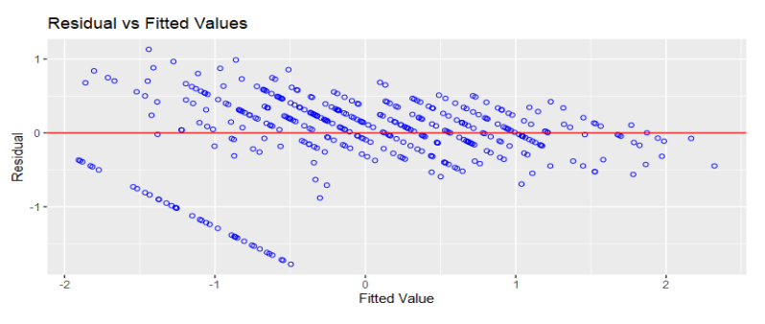
Residual Analysis
Residuals are the observed errors i.e. difference between observed response variable and predicted response variable. Now the model part i.e. the linear part of the regressor variable is supposed to be independent of the ϵ (error component). Now error is unobserved, so it is best explained by the residuals of the model. Also, errors are linearly independent from the predicted response variable. Hence, if we plot the predicted response and the residuals then the points must be scattered within a horizontal strip around the origin. For our model –

Slide 25
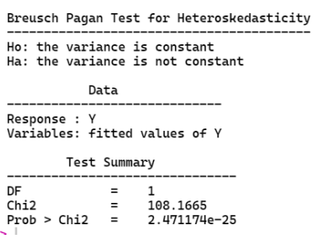
Homoscedasticity Checking
In the basic linear model assumption we assume that the distribution of error is homoscedastic but now we have to justify our assumption. Here we generally test the hypothesis that whether the distribution has a constant variance or not and if the p-value is less than 0.01 we reject our assumption of homoscedasticity at 1% level of significance.
From the above hypothesis it is readily obvious that the given sample is not from the distribution with constant, since the p-value corresponding to each test is less than 0.01. So we can safely reject the null hypothesis i.e. the distribution has a constant variance.

Slide 26
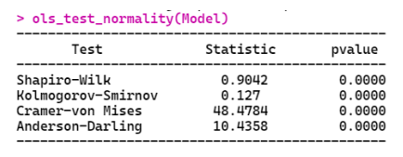
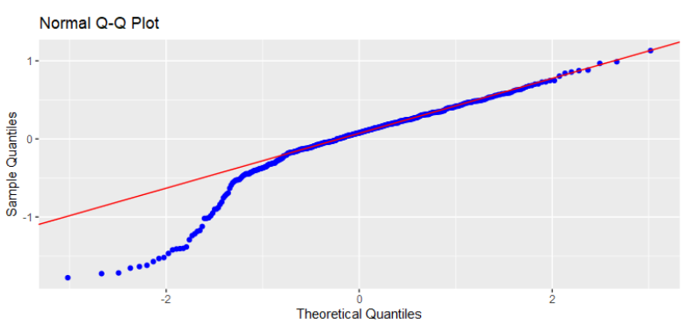
Normality Assumption
For any further propagation it is necessary to assume the normality of the error as assumed previously. So the Q-Q plot corresponding to our data-set - -
Since nearly the beginning, approximately 25% observations falls bellow the normality line we can’t safely assume the normality assumption for our model.
Theoretical Checking
From the above hypothesis it is readily obvious that the given sample is not from the normal distribution, since the p-value corresponding to each test is less than 0.01. So we can safely reject the null hypothesis i.e. the distribution is normal.

Slide 27
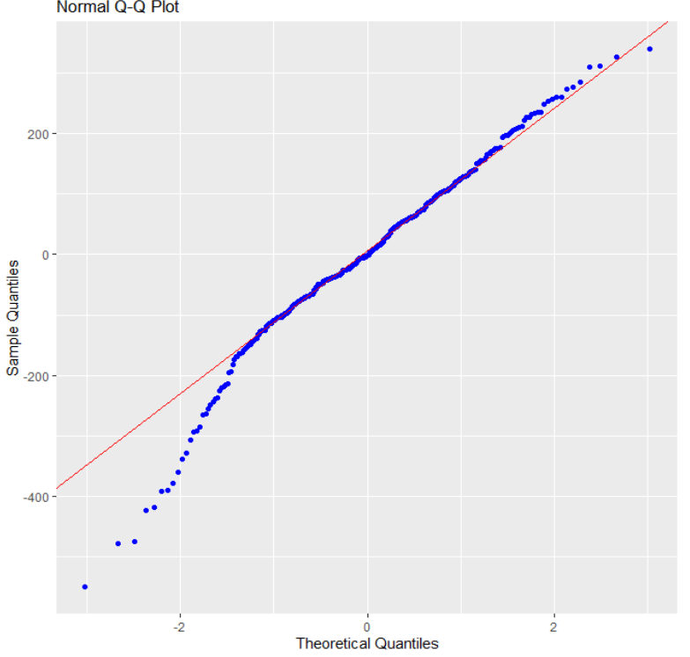
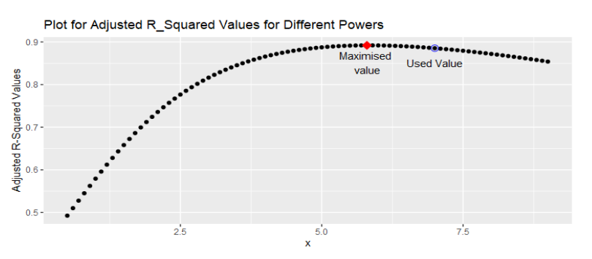
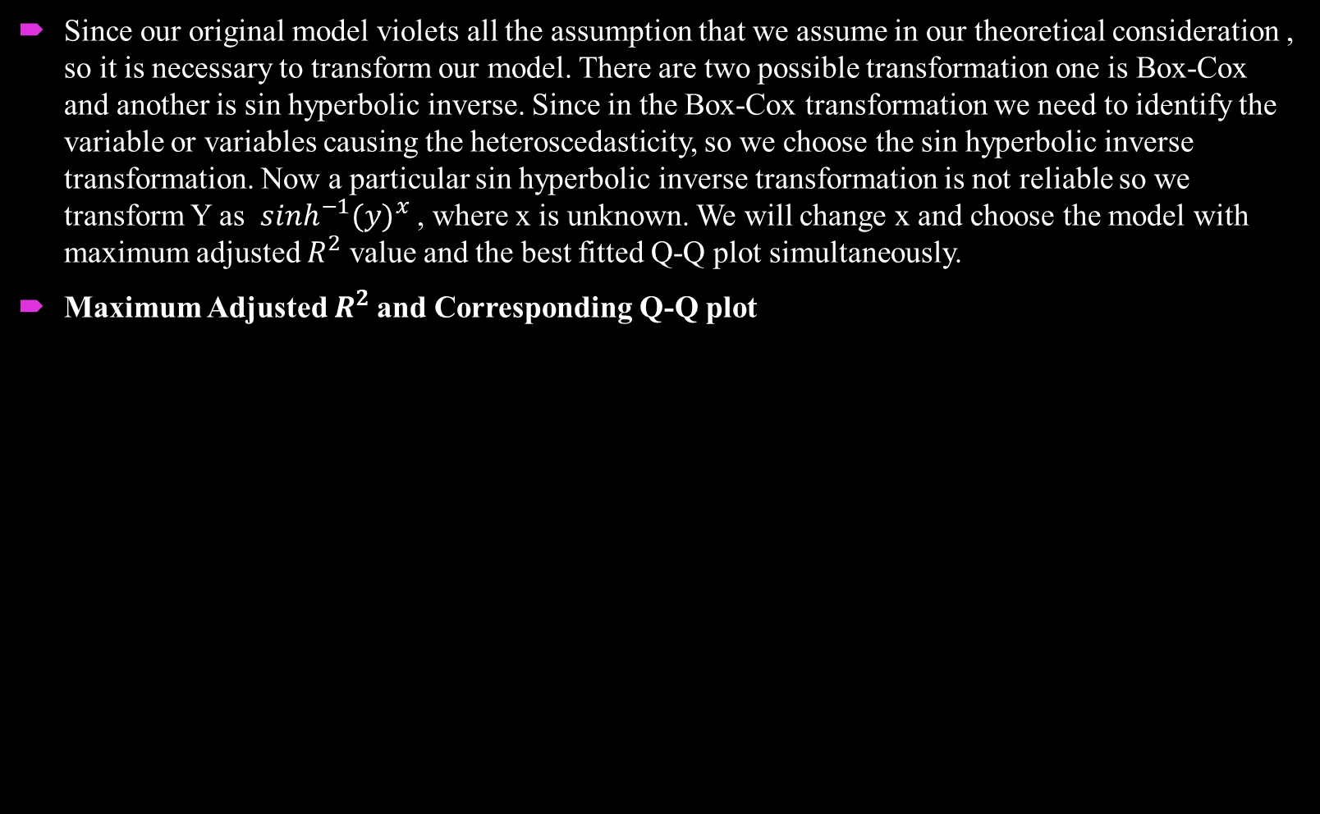
Transformed Model
Since our original model violets all the assumption that we assume in our theoretical consideration , so it is necessary to transform our model. There are two possible transformation one is Box-Cox and another is sin hyperbolic inverse. Since in the Box-Cox transformation we need to identify the variable or variables causing the heteroscedasticity, so we choose the sin hyperbolic inverse transformation. Now a particular sin hyperbolic inverse transformation is not reliable so we transform Y as $\sinh^{−1}{(y)}^{x}$ , where x is unknown. We will change x and choose the model with maximum adjusted $R^{2}$ value and the best fitted Q-Q plot simultaneously.
Maximum Adjusted $R^{2}$and Corresponding Q-Q plot

Slide 28
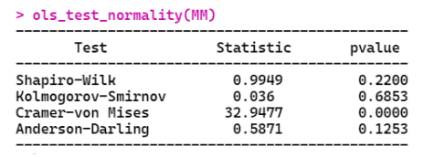
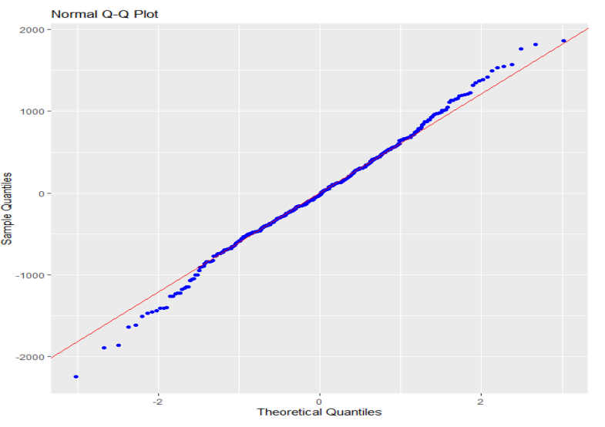

Normality Assumption
In this plot the red point indicates the point with maximum adjusted $R^{2}$ and the blue circle indicates that the point with better Q-Q plot. Since the surface of maxima is flat so we can choose the value with blue circle and the value of x at that position is 7.0. Let us now see the Q-Q plot corresponding to the transformed model –
Normality Assumption
Now the above table of test statistic and their corresponding p-value suggests that the normality assumption is not violated, since the p-value corresponding to three tests out of four suggests that the sample is from normal distribution as the values are greater than 0.05. So we finally securely say that the error distribution is normal. Now all of our basic assumptions are satisfied, so finally we try to see the model summary and residual analysis of our final transformed model

Slide 29
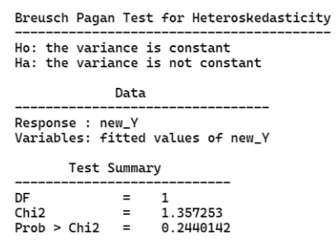
Homoscedasticity Checking for Transformed Model
Since the p-value is greater than 0.05, so we fail to reject the null hypothesis and the our assumption of homoscedasticity is validated.

Slide 30
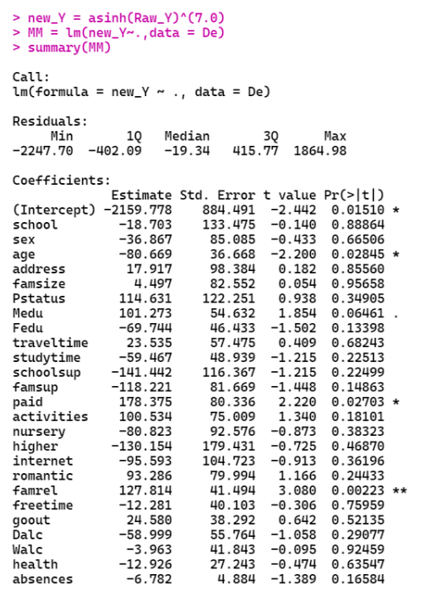
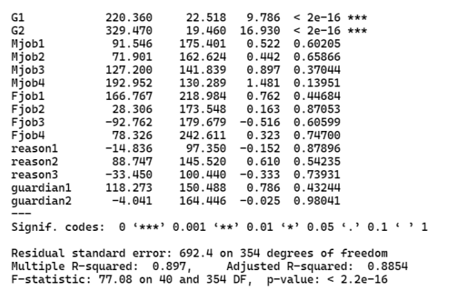

Transformed Model Summary and Residual Analysis
For the final transformed model, let us summarize all the information. Here our main target is to see what is the adjusted $R^{2}$ for this model.

Slide 31
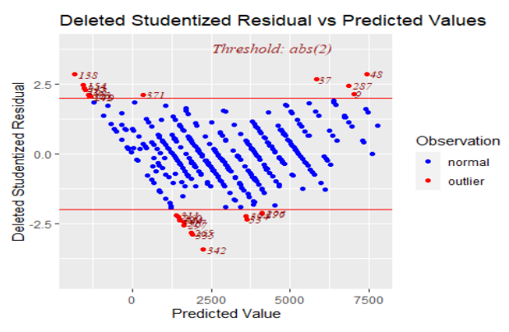
Residual Plots
By different residual plot we actually try to see whether our model looks fine or it again includes some of the difficulty. so this we first plot the R studentized residuals or the deleted studentized residuals against the predicted response variable. And the plot is type following –
The observations lying outside the threshold line are the outliers and since they are small in compare to the data-set so we will ignore the outliers for our model.

Slide 32
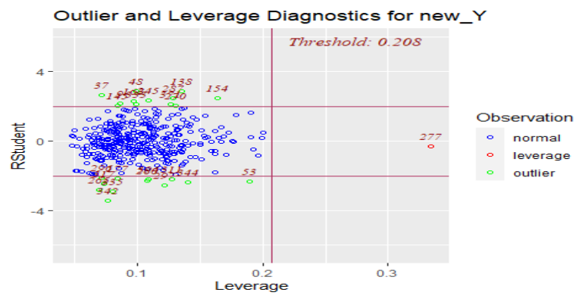
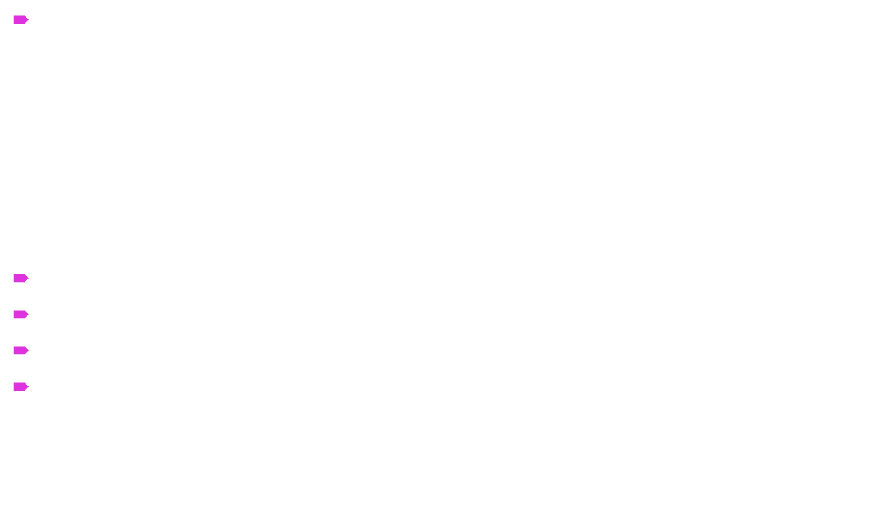
Leverage points
In statistics and in particular in regression analysis, leverage is a measure of how far away the independent variable values of an observation are from those of the other observations. High leverage points, if any, are outliers with respect to the independent variables. That is, high-leverage points have no neighboring points in $R^{p}$ space, where p is the number of independent variables in a regression model. This makes the fitted model likely to pass close to a high leverage observation. Hence high-leverage points have the potential to cause large changes in the parameter estimates when they are deleted i.e., to be influential points. Although an influential point will typically have high leverage, a high leverage point is not necessarily an influential point. The leverage is typically defined as the diagonal elements of the hat matrix. Let us now see the residual and the leverage plot for our data-set –
The only red point which is far apart from the
the usual residuals is the only leverage point
for our data-set and we have to remove this
point for better fitting out model.

Slide 33
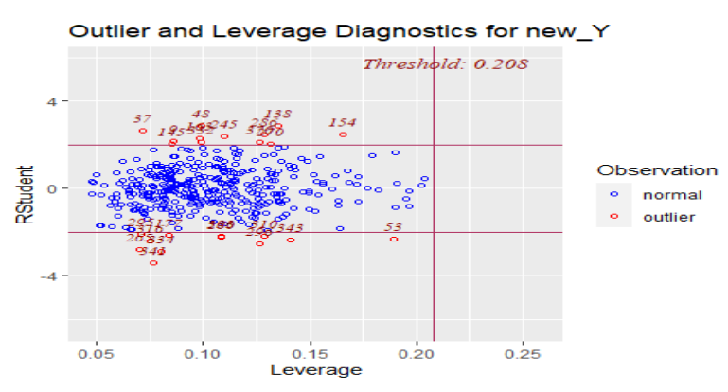
Removing Leverage point

Slide 34
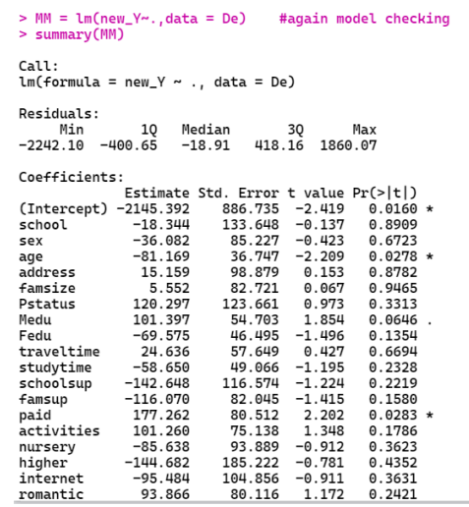
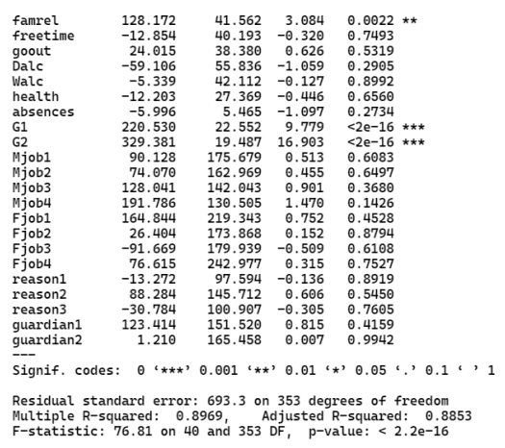

Model Summary After Removing the Leverage Point
Since the and the adjusted $R^{2}$ value and also the model parameters are approximately same as that of the previous model, hence we can say that there is not a significant effect of the leverage point in our model.

Slide 35
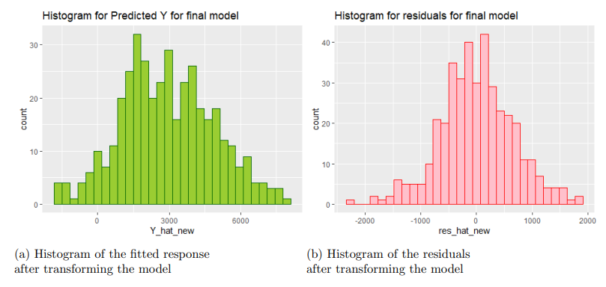
Residual And the Predicted Response
Now let us plot the residuals and the predicted response variable by the histogram to see the ultimate behavior of our final transformed model.

Slide 36
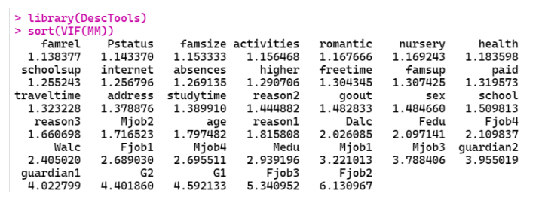
Multicollinearity
Variance Inflation Factor (VIF)
 If VIF value is greater then 5, we can say that multicollinearity is present in the model.  Else multicollinearity is not present in our model.
Now the VIF values for our model –

Slide 37
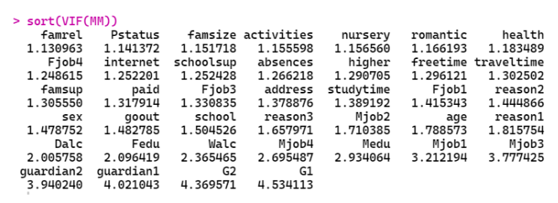
After Removing the Column With Multicollinearity
Since Fjob3 and Fjob2 has VIF value greater than 5 So we can drop the highest one and check the VIF again.
Since none of the variable has VIF value greater than 5, hence we can conclude that the number of regressor included in our model are free from multicollinearity and this is our final model before the variable selection procedure has been done

Slide 38
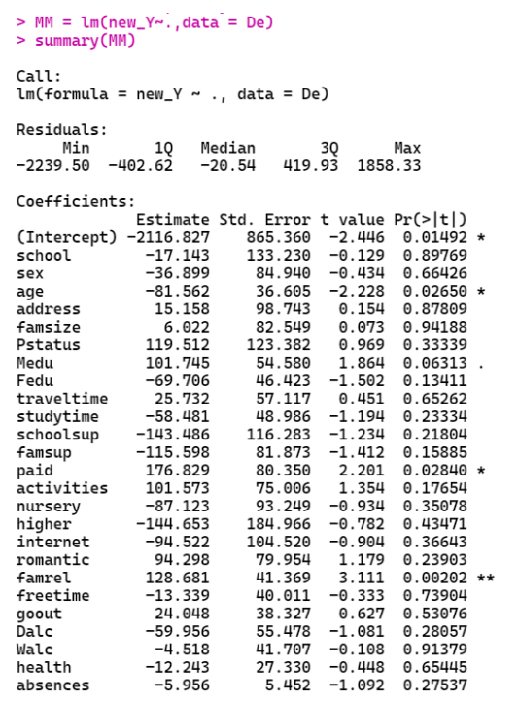
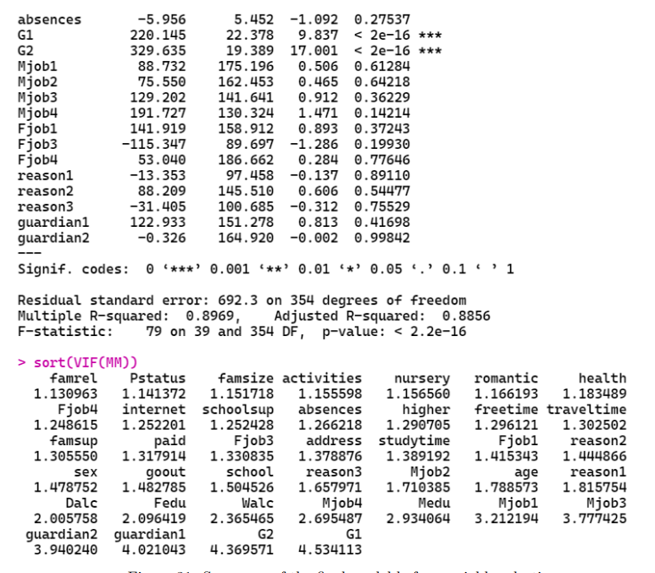
Our Final Model Summary
Now the final model summary is described as –

Slide 39
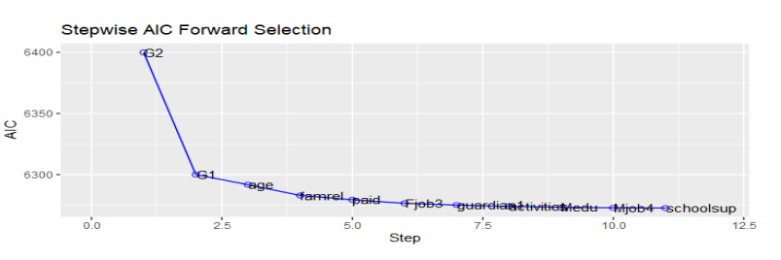
Variable Selection
Forward Selection
For our model the forward selection curve and the summary of the selected model is the following

Slide 40
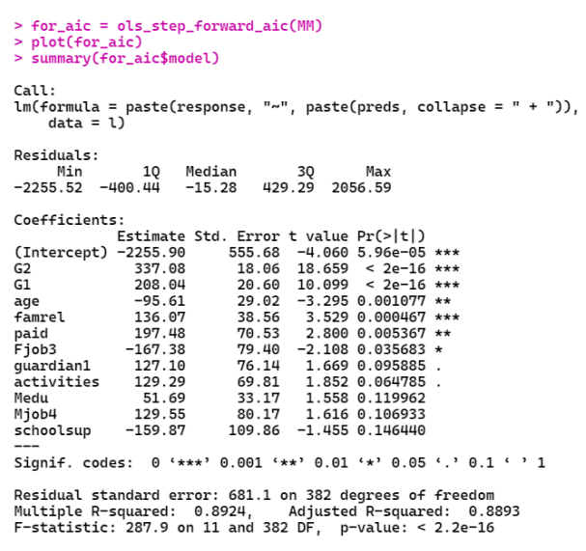

Summary For the Forward Selection Model
This model has only 11 variables and the adjusted $R^{2}$ value is 0.8892 which is nearly the same as the previous. So this model is as good as the previous one but has a big advantage that here the number of variables is only 11 nearly one-forth than the previous.

Slide 41
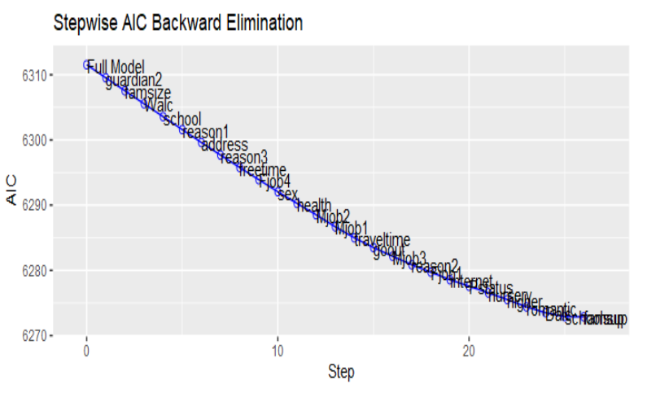
Backward Elimination
Backward Elimination
For our model the backward elimination curve and the summary of the selected model is the following –

Slide 42
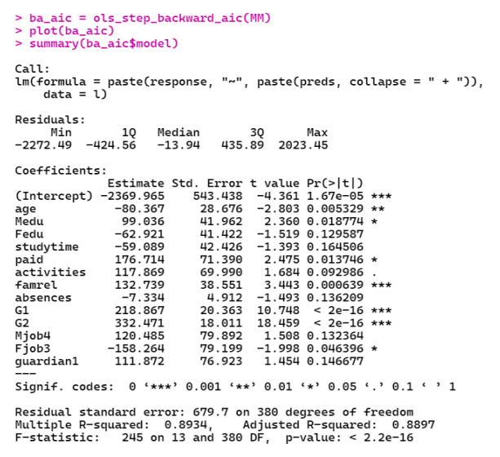

Summary For the Backward Elimination Model
This model has only 13 variables and the adjusted $R^{2}$ value is 0.8897 which is nearly the same as the previous. So this model is as good as the previous one but has a big advantage that here the number of variables is only 13 nearly one-forth than the original model and approximately same as the forward selection model.

Slide 43
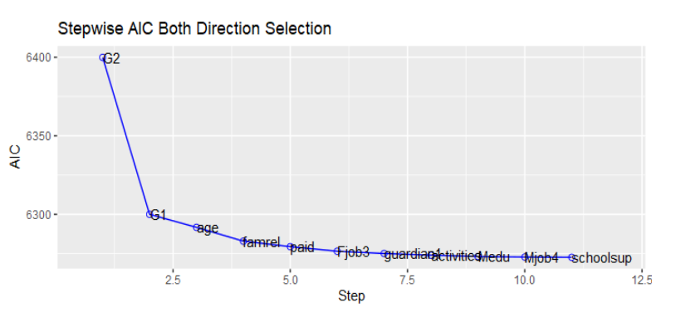
Stepwise Selection
Stepwise Selection
For our model the stepwise selection curve and the summary of the selected model is the following

Slide 44


Summary For the Stepwise Selection Model
This model has only 13 variables and adjusted $R^{2}$ the value is 0.8897 which is exactly the same as the previous. So this model is as good as the original one but has a big advantage that here the number of variables is only 13 nearly one-forth than the original model and approximately same as the forward selection model.

Slide 45
Conclusion
Here all the three model suggests nearly the same amount of regressor variables and also approximately same adjusted R-squared value. So we can choose any one of them safely. Since the stepwise selection is a selection procedure that takes into account both the forward selection and the backward elimination i.e. a combination of the above two method, we can select the final model as the model selected by the stepwise selection procedure. We can finally conclude that the student’s grade can be modeled or predicted with approximately 89% accuracy based on the variable selected by the stepwise selection procedure.

Slide 46

Thank you

